Slide 1
Overview slides
January 2024
Notes:
There are 4 variations of the title page created in the Master Slides. To choose another option right click on the slide > Layout > and choose your desired design
To change the background image: Right click on the background image > Format Background > Fill > Picture or texture fill > Picture source > Insert > From a file (or online) > select you image and press Open.

Slide 2


Datasets
Hosted portals
91,826
19
Country Participants
62
Peer-review papers
using data
9,923
Organizational Participants
Average records
downloaded per month (2023)
43
173.8 billion
Species
occurrence records
Publishers
2,170
2,627,518,860
By the numbers | 1 January 2024
www.gbif.org
Notes:
Frequently used slide, redone
Please copy and paste these to your slides and never make any changes to them directly in the toolkit.
Useful to see GBIF in its different modalities:
A window on biodiversity
An informatics infrastructure focuseD on tools and standards in service to science and society
A global network on bioinformatics

Slide 3
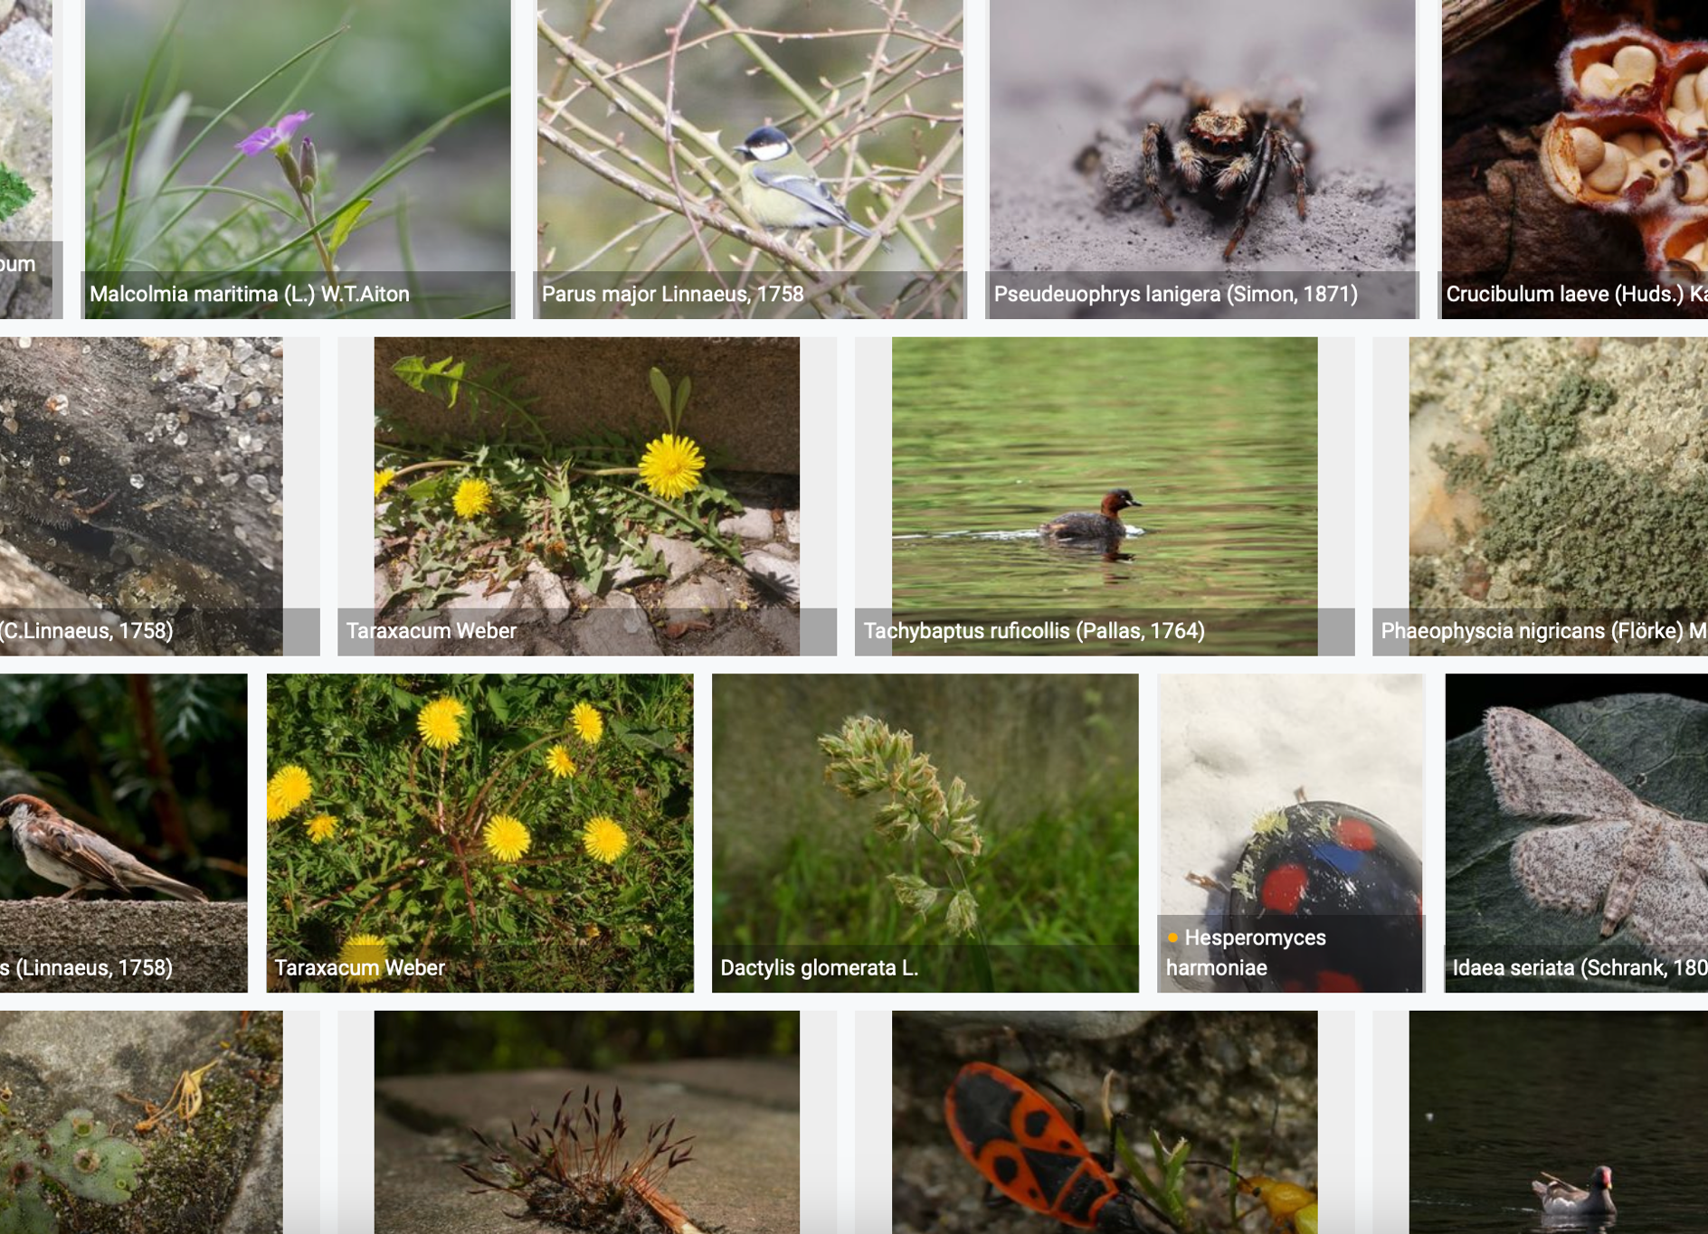
Species occurrence records with multimedia evidence: 2023
1 January 2024
166.4 million records with taxonomically identified images
104.8 million human observations
56.7 million specimens
2.8 million material samples
1.4 million fossil specimens
1,281,667 audio files
8,195 videos
https://www.gbif.org/occurrence/gallery

Slide 4
GBIF Participant countries
1 January 2024
Voting Participants
Associate Participants
Notes:
vv

Slide 5
GBIF network of data publishing institutions
1 January 2024
142
countries/areas with institutions
sharing data through GBIF
Number of active publishers by country or area

Slide 6
GBIF.org traffic by country: 2023
1 January 2024
Rank | Country/Territory | Visitors | Visits | Effective visits* | % Effective visits | 2022 rank | Pages / visit
1 | United States | 773,254 | 916,812 | 375,893 | 10.71% | 1 | 4.50
2 | Colombia | 350,149 | 451,611 | 221,289 | 6.30% | 2 | 4.38
3 | Brazil | 334,182 | 393,515 | 177,082 | 5.04% | 4 | 4.22
4 | Mexico | 344,338 | 408,154 | 167,343 | 4.77% | 5 | 4.27
5 | Indonesia | 225,758 | 280,575 | 162,774 | 4.64% | 7 | 5.90
6 | France | 324,514 | 387,006 | 158,672 | 4.52% | 9 | 4.42
7 | China | 189,141 | 267,239 | 154,999 | 4.42% | 3 | 10.02
8 | Spain | 248,731 | 315,051 | 154,375 | 4.40% | 6 | 5.97
9 | Germany | 265,968 | 325,439 | 143,193 | 4.08% | 10 | 5.54
10 | India | 273,665 | 308,495 | 114,143 | 3.25% | 11 | 3.55
 | TOTAL | 6,355,4029 | 7,797,044 | 3,508,670 | 100.00% |  | 5.09

Slide 7
Occurrences published by country: 2023
1 January 2024
Rank | Country/Territory | 2023 | 2022 total | 2022 rank
1 | United States | 151,004,708 | 123,152,046 | 1
2 | United Kingdom | 36,220,446 | 14,602,384 | 6
3 | Canada | 22,744,659 | 22,328,115 | 4
4 | Netherlands | 14,293,849 | 30,330,743 | 3
5 | France | 13,208,845 | 40,243,552 | 2
6 | Sweden | 9,339,841 | 13,698,583 | 7
7 | India | 8,543,437 | 7,300,428 | 9
8 | Spain | 7,633,366 | 5,058,667 | 13
9 | Colombia | 7,145,173 | 6,052,455 | 12
10 | Brazil | 4,593,508 | 2,721,541 | 19
OTHER COUNTRIES + AREAS | OTHER COUNTRIES + AREAS | 81,266,325 | 66,653,115
TOTAL |  | 355,993,458 | 369,598,387
Notes:
This is a live doughnut pie chart representing different theme colours and how they work, placed next to one another.
You do not have to use the same exact chart, you can simply create your own by clicking on:
Insert tap on the ribbon > Click on Chart > chose a chart of your choice (in this example I chose, Doughnut) > add in your data in the automatically opened Excel sheet and see your chart changing and adopting to the new information you have entered in the data sheet.

Slide 8
Data download requests by country: 2023
1 January 2024
Rank | Country |  | 2023 | 2022 total | 2022 rank
1 | China | 39,253 |  | 36,844 | 1
2 | United States | 34,275 |  | 24,812 | 3
3 | Mexico | 26,051 |  | 27,172 | 2
4 | Colombia | 19,341 |  | 18,392 | 4
5 | Brazil | 18,370 |  | 14,777 | 5
6 | Spain | 13,492 |  | 9,280 | 7
7 | United Kingdom | 10,044 |  | 10,256 | 6
8 | France | 7,248 |  | 5,231 | 9
9 | Canada | 6,649 |  | 4,782 | 10
10 | Germany | 5,788 |  | 4,590 | 11
OTHER COUNTRIES + AREAS | ALL OTHERS | 87,262 |  | 75,107
TOTAL |  | 267,773 |  | 232,591
168
countries, islands & territories where users have ≥5 requested downloads
Notes:
NB: 2023 totals account for multiple recurrent downloads by scripts and bots that are discarded, removing the following number from national totals:
Argentina: 2,624
Bangladesh: 1,208
Belgium: 6,423
Brazil: 503
Canada: 509
Chile: 732
China: 63,497
Colombia: 7,301
Denmark: 13,981
Finland: 1,837
France: 14,694
Germany: 653
Greece: 1,380
Guatemala: 1,690
Hong Kong: 3,248
Hungary: 512
India: 2,200
Italy: 5,131
Japan: 179,002
Mexico: 6,416
Netherlands: 1,884
Norway: 14,114
Serbia: 554
Spain: 1,392
Switzerland: 3,666
Ukraine: 1,948
United Kingdom: 3,122
United States: 10,949

Slide 9
Peer-reviewed publications using GBIF-mediated data
1 January 2023
Notes:
The next 3 slides are showcasing PPT standard or Live charts.
To create a chart simply click on the Insert tap on the ribbon > Click on Chart > chose a chart of your choice (in this example I chose, Bar) > add in your data in the automatically opened Excel sheet and see your chart changing and adopting to the new information you have entered in the data sheet.

Slide 10
Data use in peer-reviewed journals: 2023
1 January 2024
Peer-reviewed uses by country
Peer-reviewed uses by region
End of Year |  |  | 2023 total | 2022 total | 2022 rank
1 | United States |  | 387 | 306 | 2
2 | China |  | 381 | 309 | 1
3 | Brazil |  | 191 | 167 | 3
3 | United Kingdom |  | 182 | 149 | 4
5 | Germany |  | 163 | 126 | 6
6 | Spain |  | 130 | 105 | 7
7 | Mexico |  | 129 | 140 | 5
8 | France |  | 108 | 78 | 8
9 | Australia |  | 94 | 78 | 8
10 | Italy |  | 79 | 66 | 9

Slide 11
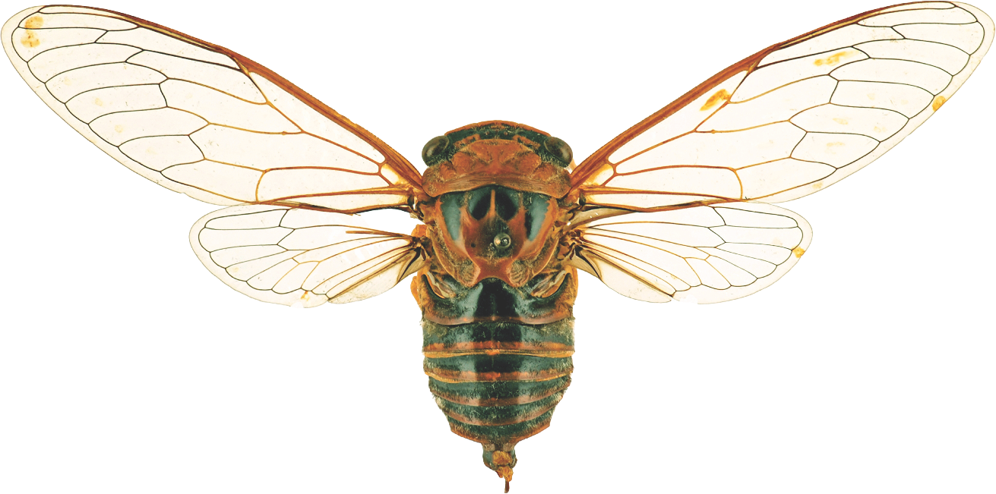
Suggestions reviewed
Institutions
7,864
1,378
vv
Countries
Collections
92
7,403
Mediators
Digitized specimens
52
210,856,531
GRSciColl by the numbers | 25 Jan 2024
gbif.org/scientific-collections

Slide 12
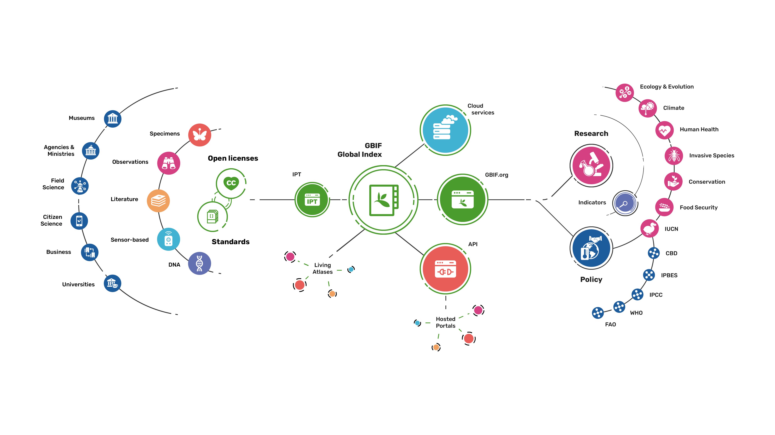
Providing biodiversity evidence for research and policy

Slide 13
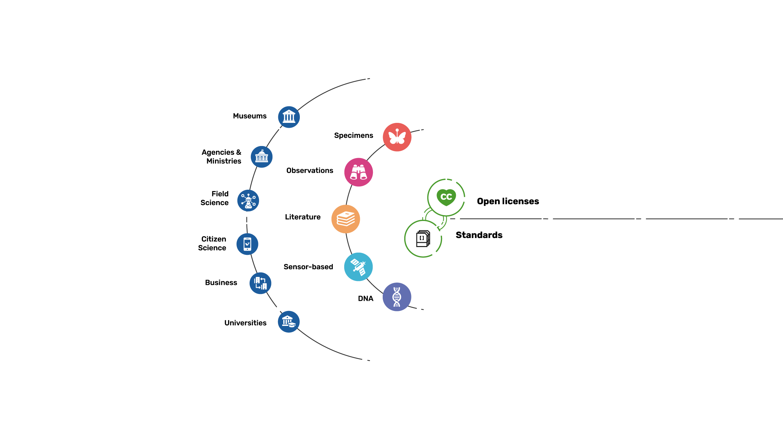
Sources of biodiversity evidence
Create
Combine sources of evidence

Slide 14
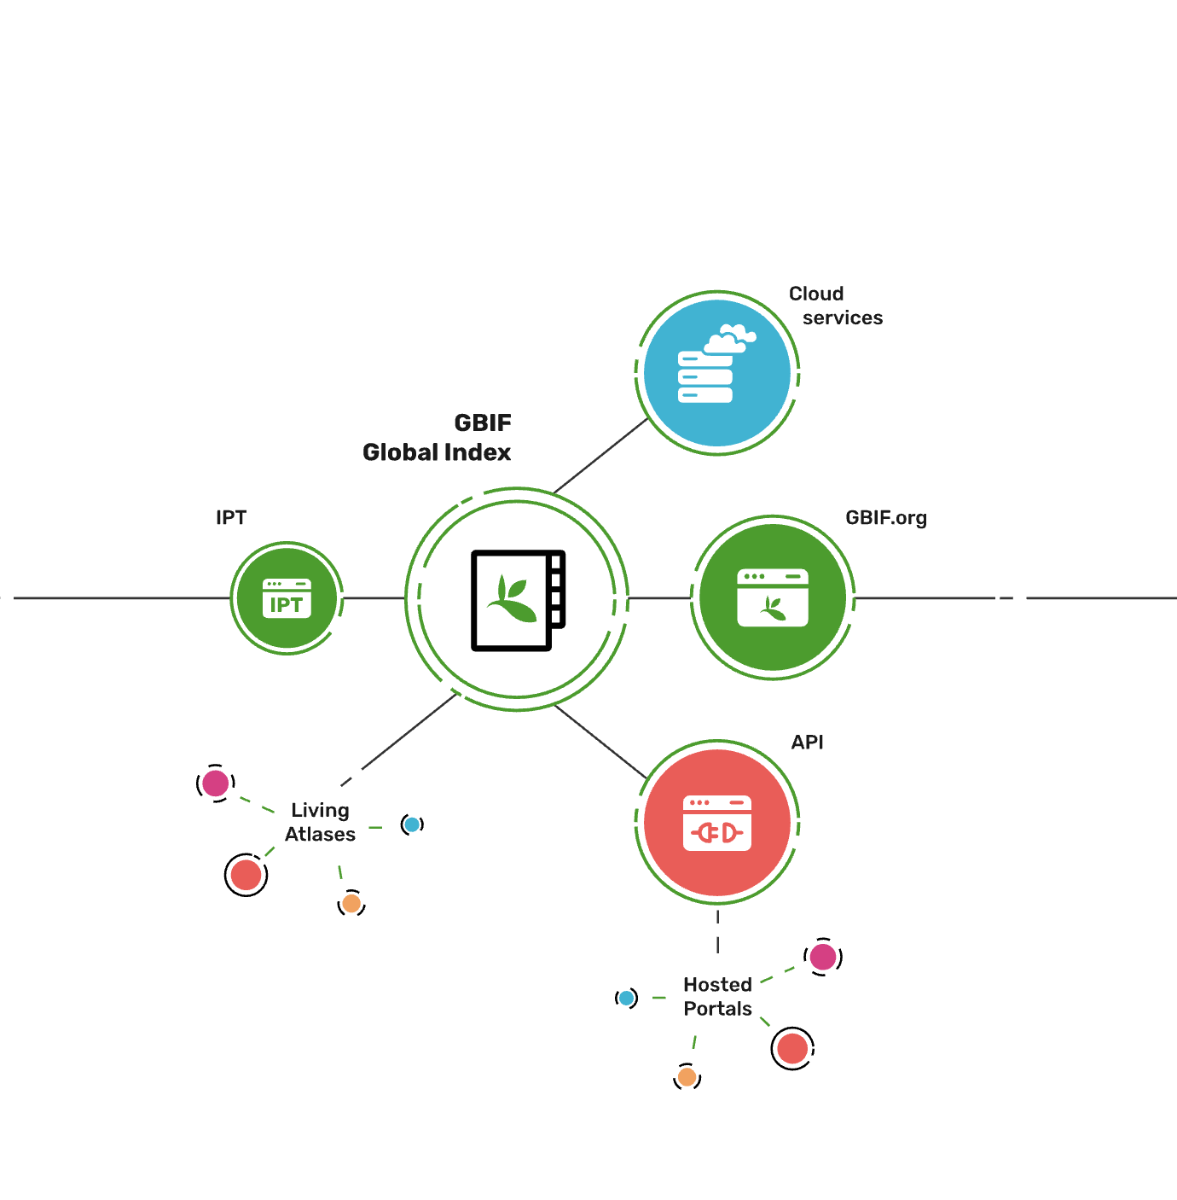
Access to biodiversity evidence
Share
FAIR and open access

Slide 15
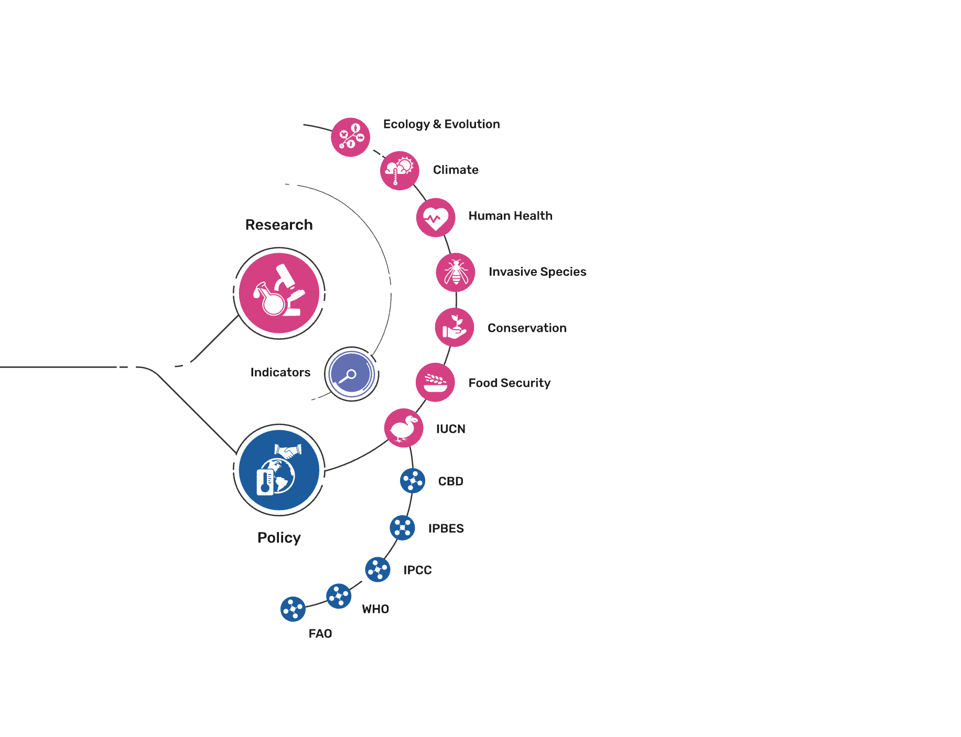
Uses of biodiversity evidence
Transform
Apply and use data

